Slide 1
Redefining Football with Audiovisual Innovation
"WhizThinkers transforms football engagement with immersive, AI-powered audiovisual experiences—from tactical AR insights to personalized highlight and performance feedback reels."
Mujitha Bai K B
Founder - WhizThinkers
https://whizthinkers.com/
17-June-2025

Slide 2
The Problem
Limited real-time tactical visualizations for coaching & analysis
Fragmented highlight and performance content
Lack of engaging content for audiences
Passive fan experience during matches

Slide 3
Our Solutions
1) AR Tactical Insights:
Real-time overlays showing player movements, heat maps, tactical shapes (for coaches, fans, content creators)
2) Personalized Highlight & Performance Feedback Reels:
AI-curated match clips for fans, players, and sponsors
3) Interactive Second Screen App:
Live stats, polls, quizzes, and visual content synced with game play

Slide 4
Our Vision / Mission
Vision: "Revolutionize engagement with immersive AV innovation"
To revolutionize how fans, players, and clubs engage with football through immersive, intelligent audiovisual experiences.
Mission: "Bridge performance, entertainment, and education with AI“
Build scalable AV solutions that bridge performance, entertainment, and education in football—powered by AI and interactive tech.

Slide 5
Why Now / Market Opportunity
Post-COVID digital acceleration in sports
Booming second-screen and OTT markets
Real Madrid’s strong Asia fan base = ready audience

Slide 6
Why WhizThinkers?
Expertise in Generative AI + AV innovation + sports tech
Already prototyping overlays and highlights
Founders are passionate footballers, with deep tech & innovation experience
Co-creation ready with lean iterative development

Slide 7
Our Key Differentiators in Football AV Innovation
# | Differentiator | What Makes It Unique
✅ 1 | Hyper-Personalization Engine | AI-tailored AV outputs for each player, coach, or analyst — not one-size-fits-all.
✅ 2 | Creative-AI Co-Design Interface | Players or coaches co-create highlight visuals, breakdowns, or tactical content with AI via an intuitive no-code studio.
✅ 3 | Multi-Format Outputs from One Input | Turn one match moment into video, voice-over, stat breakdown, player card, and summary — instantly.
✅ 4 | Emotion-Driven Storytelling | Emotion-aware editing that adapts music, pacing, and transitions to the emotional flow of the game.
✅ 5 | AI Feedback & Performance Analytics | Intelligent gameplay review with improvement suggestions for player technique, tactics, or decision-making.
✅ 6 | Live AI Interaction Mode | Real-time fan engagement tools: second-screen highlights, AI-generated tributes, match dedications, interactive memory wall.
✅ 7 | Cross-Domain Creative Fusion | Combines cinematic storytelling (from weddings) with tactical insight (from sports) to elevate highlight content.
✅ 8 | Pre-Match AV Simulation Tools | Simulate camera angles, tactical visualization, lighting, or crowd mood before the match for better planning.

Slide 8
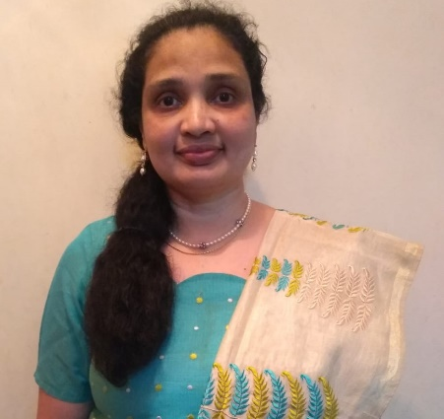
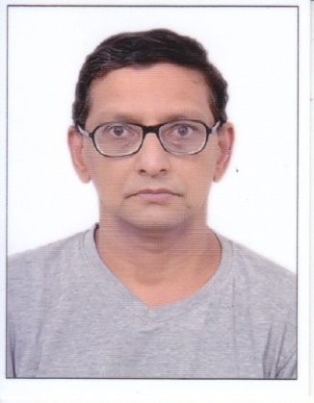
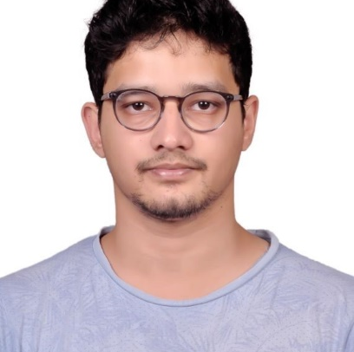
Our Team
Mujitha Bai K B
Jalaludeen C A
Architect & Technology Specialist
Fan Experience Strategist
M.Tech IIT Mumbai (20 yrs in IT)
Healthcare/Sports SME, Architect, Data Scientist, UX Researcher/Designer
Experience: Strategic leader and Technical Architect in MNCs
https://www.linkedin.com/in/mujitha
M.Tech IIT Delhi (25 years in DSP, ML)
Operations, GTM, Research/Setup IT environments, AI/ML platforms
Experience: India RnD leader, Organization head in MNCs
https://www.linkedin.com/in/jalaludeen-c-a-aa74983/
Dr. Ajil Jalal
Dr. Aathif Jalal
Lead AI Scientist
(a passionate footballer)
Lead Tactical Analyst
(a passionate footballer)
B.Tech IIT Madras, PhD UT Austin, Texas PostDoc UC Berkeley, California
His research explores the theoretical and practical aspects of techniques that use deep generative models (2540 citations – Google Scholar)
https://www.linkedin.com/in/ajil-jalal-6003486b/
MS General Surgery, KMC Manipal
MBBS – MRMC Gulbarga, Rajiv Gandhi University, Karnataka
8

Slide 9
Real Madrid Use Case
Example: "Jude Bellingham Tactical Highlights"
Create AR-enhanced tactical visualizations for Real Madrid Academy
Generate player-specific highlight reels for La Liga fans in Asia
Offer localized match companion apps for Asian markets
Create immersive match-day AV bundles for fan engagement

Slide 10
Business Model & Scalability
B2B2C model: Sell to clubs, monetize through fans
Subscription & licensing for:
AV content modules
Player/coach performance tools
Sponsor-branded fan engagement packages

Slide 11
Roadmap & Growth Plan
Q3 2025: Prototype AR Tactical & Highlights Modules
Q4 2025: Pilot with Real Madrid Academy / Fan base
Q1 2026: Launch in Asia
Q2 2026: Monetize & expand globally

Slide 12
The Ask / Why Real Madrid Accelerator
Co-develop & validate within Real Madrid’s ecosystem
Seeking co-development opportunity with Real Madrid’s AV and coaching team
Pilot AR-Tactical & Highlights innovations with academy matches
Tap into global club networks
Expand innovation across Asia
Expand in Asia with Real Madrid’s brand support
Lead global AV fan and player innovation
Mentorship, validation, and market reach

Slide 13
THANK YOU!!!!

